Slide 1

2020-21 Budget Development
University Budget Advisory Committee
November 26, 2019

Slide 3
Key Budget Changes
2019 General Assembly
  Salary Increases
    Classified - - 2.75% across-the-board + 2.25% merit
    Faculty - - 3.0% across-the-board
  Health Insurance Premium Holiday
    Two pay periods - - October 2019
  Tuition Affordability Pool
    No tuition increase for resident undergraduate
    UMW - $957,000 in additional state funding
      Equivalent to 3% increase

Slide 4
Key Budget Changes
2019 General Assembly (cont’d)
  Career Center - - $375,000
  Degree Production - - $338,550
  O&M for new facilities - - $50,000
  State Financial Aid Program
    Need-based, Virginia undergraduates
    + $389,281 - - Total of $3.7M
  Equipment Trust Fund
    No change - - $655,746
  3% Cap on Non-E&G Fees

Slide 5
Key Budget Changes
UMW Actions
  Privatized Bookstore - - Barnes & Noble
    $2M impact on revenues and expenditures
    B&N pays UMW commissions + overhead
  Residence Hall Renovation Pool
    + $995,000 - - debt service for Virginia Hall
  Institutional Financial Aid
    + $2.1M - - Total budget of $9.6M

Slide 7
What’s Driving Student Aid Increases?
Competitive market place
  Ability to pay vs willingness to pay
UMW is disadvantaged by state aid program
  Institutional aid to used to cover the shortfall in state funding
  UMW ranks 10th out of 15 unmet need funded
  State model is slow to reflect institutional demographic changes
    Increase of 229% in Pell eligible students at UMW since 2006-07, largest increase of any Virginia public institution, which have averaged 94%

Slide 8
Key Budget Changes (cont’d)
Collapsing Tuition and E&G Comp Fee has no impact on student costs
Full-time, Virginia undergraduate

Slide 9
Key Budget Changes (cont’d)
Develop a multi-year strategy to align room and board charges with operating budgets

Slide 10
Tuition & Fees

Slide 11
Tuition and Fees for 2019-20

Slide 12
How Do UMW’s Tuition & Fees
Compare to Other Virginia Public
Universities for 2019-20?

Slide 14
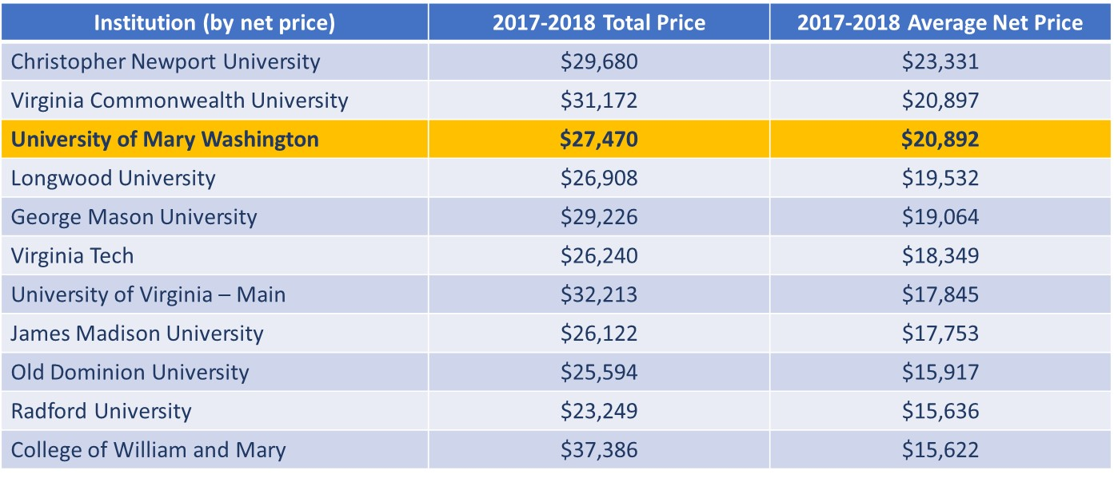
Virginia Institution Pricing
Source: NCES College Navigator

Slide 15
Capital Outlay

Slide 16
Current Capital Projects
Seacobeck Hall Renovations
  Currently on-hold pending additional funding request
  2020 General Assembly
Jepson Science Center Addition and Renovations
  Fall 2019
Willard Hall Renovation
  $24.5 million in revenue bonds
  Reopen after 2019 winter break
Virginia Hall Renovation
  $24.5 million in revenue bonds
  Begin construction after Willard reopens
  Palmieri Fountain
  Reopen Fall 2021
Alvey Hall??
Maintenance Reserve – Various
  $1.7 million annually in state funds

Slide 17
FY21 Capital Priorities
New Theatre / Renovation of Fine Arts Complex
  State funding request - - $78.6 million
  New Theatre at Sunken Road and William Street
    Demolish Marshall Hall
  Renovate Pollard, Melchers and DuPont
Renovate Simpson Library
  State funding request - - $25.3 million

Slide 18
Preliminary 2020-21
Operating Budget Estimates

